Slide 1


Introduction to
Robotic Process Automation
GREENCARE ASSISTANT BOT
220701047
BLESSY ABIDHA B S
Mrs. J. JINU SOPHIA
Assistant Professor(SG), CSE Dept

Slide 2
Abstract
The Plant Care Bot is an automated solution developed using UiPath to simplify and optimize plant care schedules. It calculates watering, fertilizing, and pruning needs based on plant-specific data and integrates real-time weather information via a weather API. By collecting user inputs like plant details and last care dates, the bot personalizes care recommendations. Additionally, it automates email notifications to deliver schedules directly to users, ensuring efficient plant care management and reducing manual effort.

Slide 3
Need for the Proposed System
Plant Health Optimization: Helps maintain plant health by ensuring consistent care tailored to specific needs.
User-Friendly Interface: Simplifies complex scheduling through an easy-to-use automation system.
Eco-Friendly: Promotes efficient use of resources like water and fertilizers, reducing waste.
Scalability: Can manage care for multiple plant varieties simultaneously.
Stress-Free Gardening: Reduces the burden on users by automating routine tasks and reminders.
Modern Solution: Integrates technology like UiPath and weather APIs to address traditional gardening challenges effectively.

Slide 4
Advantages of the Proposed System
Automation of Routine Tasks: Eliminates the need for manual tracking of plant care schedules.
Personalized Recommendations: Provides tailored schedules for watering, fertilizing, and pruning based on specific plant types and user inputs.
Integration with Real-Time Weather Data: Adjusts care schedules based on weather conditions to optimize plant health.
Time-Saving: Reduces the effort required to manage multiple plants simultaneously.
Resource Efficiency: Ensures efficient use of water, fertilizers, and other resources.

Slide 5
Literature Survey
Paper 1: "Automated Plant Care Systems Using IoT and Machine Learning"
Authors: Smith et al., 2023 Summary: This paper presents an IoT-based automated plant care system that uses sensors to monitor soil moisture, temperature, and light intensity. The data is processed using machine learning algorithms to optimize watering schedules and predict plant health issues.
Advantages:
Real-time monitoring ensures up-to-date data on plant health.
Machine learning improves prediction accuracy for plant care.
Reduces manual intervention, saving time and effort.
Disadvantages:
Requires advanced hardware like sensors, which may increase costs.
Dependency on stable internet connectivity for IoT functions.

Slide 6
Literature Survey
Paper 2: "Weather-Based Irrigation Scheduling for Home Gardens"
Authors: Patel and Kumar, 2022 Summary: This study proposes a system that uses weather APIs to adjust irrigation schedules for home gardens. The focus is on water conservation and adapting plant care to environmental changes.
Advantages:
Effective integration of real-time weather data for dynamic scheduling.
Promotes sustainable water usage by avoiding over-irrigation.
Simple implementation with weather APIs, making it accessible.
Disadvantages:
Limited to weather-based scheduling, lacks plant-specific care details.
May not work effectively in indoor environments or without internet access.

Slide 7
Main Objective
Develop a Plant Care Bot using UiPath to streamline plant care schedules for various plant species.
Automate calculations for optimal watering, fertilizing, and pruning times based on plant-specific needs.
Integrate a weather API to incorporate real-time weather data into plant care recommendations.
Gather user input on last care dates and specific plant details for personalized scheduling.
Provide users with clear, actionable recommendations to ensure plant health and reduce manual tracking.
Send care schedules via email, leveraging mail automation to provide users with personalized plant care updates directly to their inbox, ensuring timely and accessible recommendations.

Slide 8
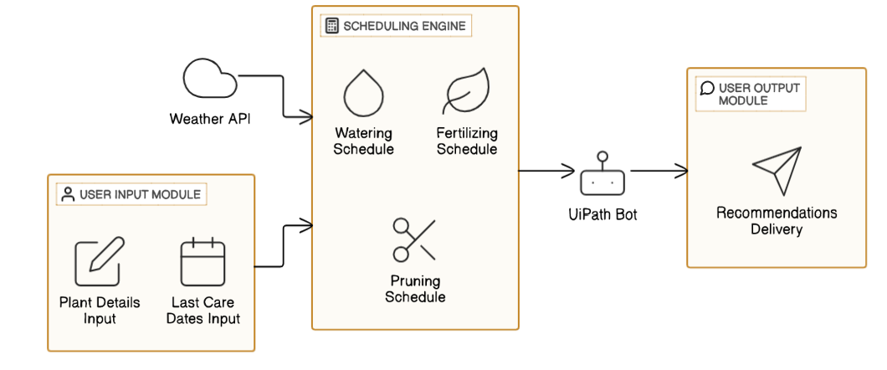
Architecture

Slide 9
System Requirements
Hardware Requirements:
Processor: Minimum Intel Core i3 or equivalent.
RAM: 4GB (8GB recommended).
Storage: At least 500MB free space.
Internet: Stable internet connection for API and email services.
Software Requirements:
Operating System: Windows 10 or later.
UiPath Studio: Community or Enterprise Edition.
Microsoft Excel: For data handling.
Email Client: Gmail (configured with App Password).
Weather API: Integrated for real-time weather updates.

Slide 10
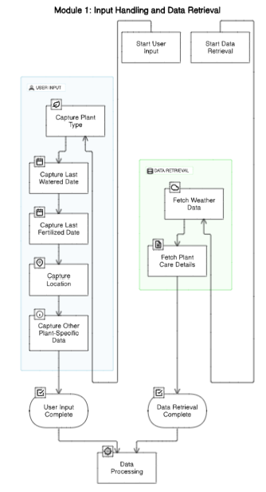
Functional Description
Module 1: Input Handling and Data Retrieval This module captures user inputs, including plant type, last watered date, last fertilized date, location, and other plant-specific data. It also retrieves real-time weather data using a weather API and fetches plant-specific care details from the Excel sheet.

Slide 11
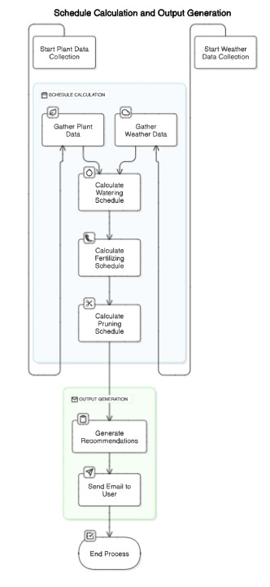
Functional Description
Module 2: Schedule Calculation and Output Generation This module calculates optimal schedules for watering, fertilizing, and pruning based on plant-specific needs and weather conditions. It also generates actionable recommendations and sends them to the user via email.

Slide 12
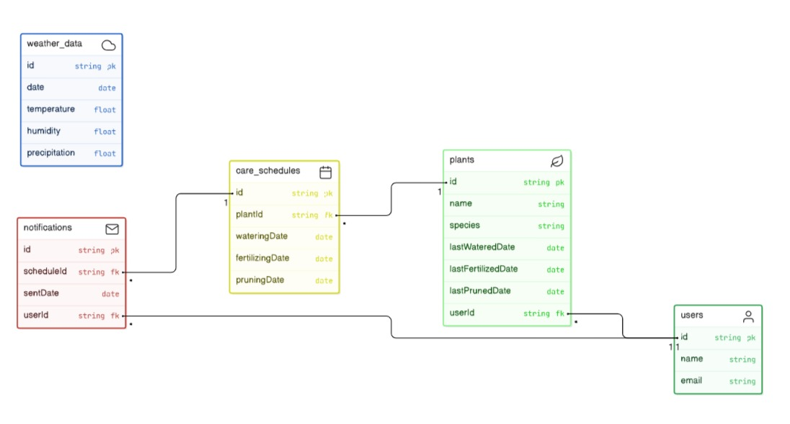
Table Design
ERD

Slide 13
Process Design
Main Process: Plant Care Scheduling
Description: Collects user input, retrieves weather data, fetches plant details, calculates
care schedules, and sends recommendations via email.
Sub-Processes:
User Input Collection: Collects plant type, care dates, and location from the user.
Weather Data Retrieval: Fetches weather data for the plant's location using an API.
Plant Data Retrieval: Retrieves plant-specific care details from an Excel sheet.
Care Schedule Calculation: Calculates watering, fertilizing, and pruning schedules based on input and weather.
Output Generation: Displays care schedules and weather recommendations.
Email Notification: Sends the care schedule and recommendations to the user via email.

Slide 14
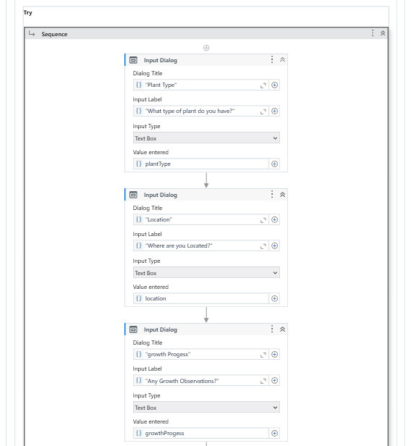
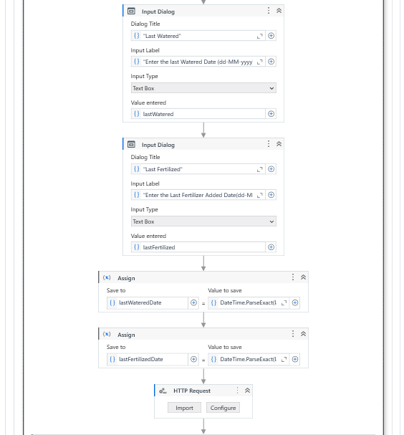
Implementation

Slide 15
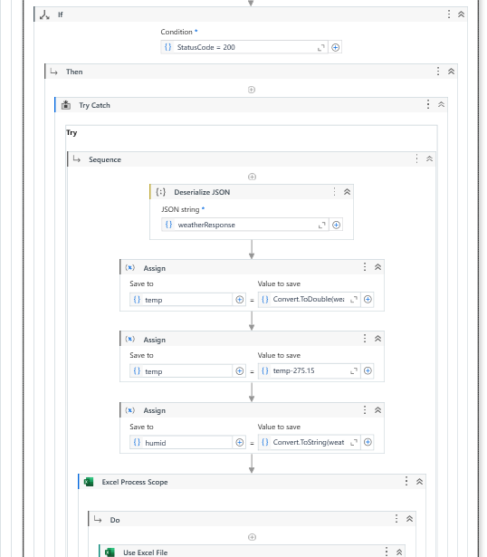
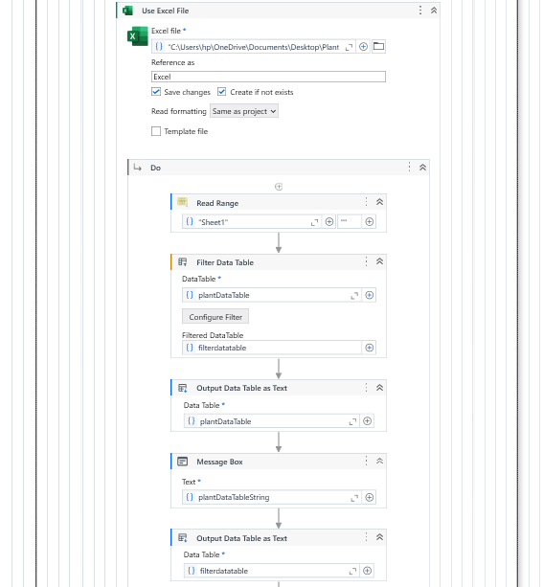
Implementation

Slide 16
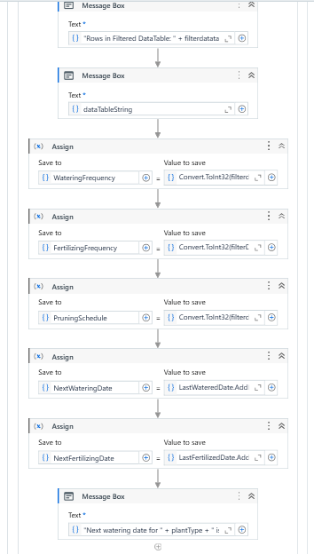
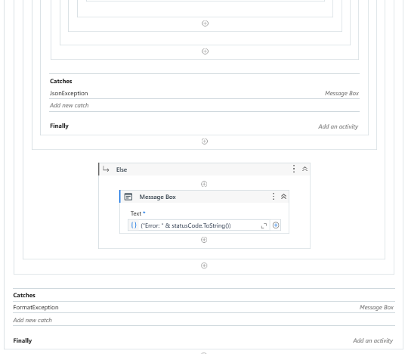
Implementation

Slide 17
Testing
Testing for the Plant Care Bot involved verifying each module, including Excel data extraction, weather API integration, and email functionality. The system was tested end-to-end to ensure smooth interactions between components, accurate plant care recommendations, and successful email delivery. User acceptance testing was conducted to ensure the bot's usability, while error handling tests ensured the system could handle issues like missing data or API failures effectively.

Slide 18
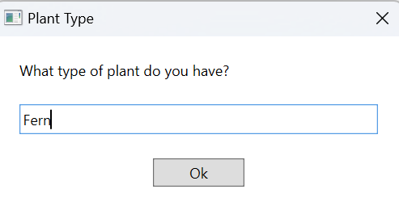
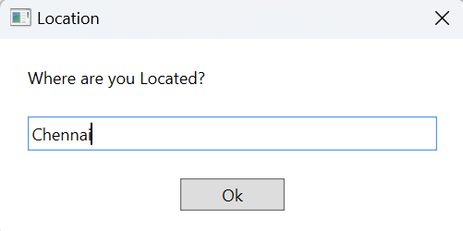
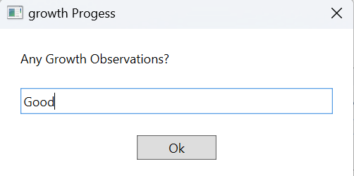
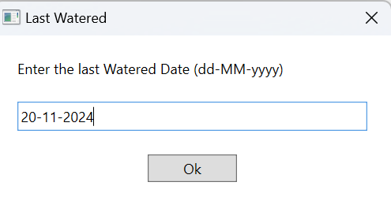
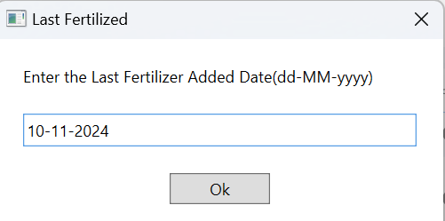
Output Screenshots

Slide 19
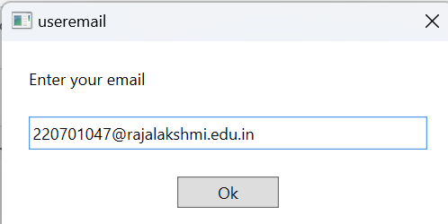
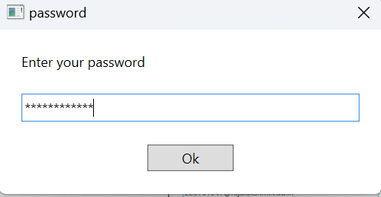
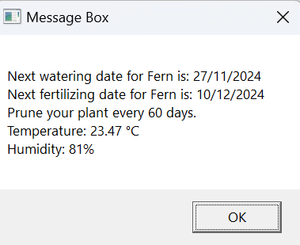
Output Screenshots

Slide 20
Conclusions
The GreenCare Assistant Bot project effectively automates the scheduling and management of plant care routines, simplifying the process for plant enthusiasts and reducing the chances of neglecting essential tasks like watering, fertilizing, and pruning. By integrating weather data, the bot provides insights into the best times for plant care based on environmental conditions. This project demonstrates the practical application of RPA in personal gardening, highlighting its potential to support sustainable plant care practices. Future enhancements could further personalize and expand the bot's functionality, making it an invaluable tool for both novice and experienced plant caretakers.

Slide 21
Future Enhancement
Expanded Plant Database: Add more plant varieties and their care requirements to the database. This only requires updating your Excel sheet or database with additional entries for new plants.
Personalized Care Recommendations: Use the existing data to provide basic personalized recommendations based on the specific care needs of each plant type, without needing complex algorithms.
Advanced Weather Integration: Use more detailed weather data (like rainfall predictions) to adjust watering schedules dynamically, ensuring more accurate care recommendations based on real-time conditions.

Slide 22
IEEE Paper
Smart Flowerpot as an IoT Device for Automatic Plant Care - Angie Killough;Anais Barja;Hakan Gurocak 2024 10th International Conference on Automation, Robotics and Applications (ICARA)
Design and Implementation of an Autonomous Plantation Layout Follower Fertilizer Bot for Advanced FarmingNachiket Sawwalakhe;Yash Jain;Shubham Patil;Ajay Jondhale;A G Keskar 2023 2nd International Conference on Paradigm Shifts in Communications Embedded Systems, Machine Learning and Signal Processing (PCEMS)

Slide 23
References
https://ieeexplore.ieee.org/document/10136100/
https://ieeexplore.ieee.org/document/10489523/
https://docs.uipath.com/robot/standalone/2023.10/user-guide/introduction

Slide 24
Thank You

